Slide 1
COMPUTER ORGANIZATION
B.TECH III SEM
CSE-4
N SANTOSHI
ASSISTANT PROFESSOR
DEPARTMENT OF ECE

Slide 2
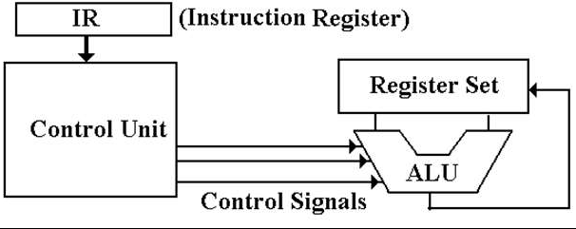
CONTROL UNIT
CPU is partitioned into Arithmetic Logic Unit (ALU) and Control Unit (CU).
The function of control unit is to generate relevant timing and control signals to all operations in the computer.
It controls the flow of data between the processor and memory and peripherals

Slide 3
There are two methods to implement the control unit:
Hardwired: The control signals are generated as an output of a set of basic logic gates, the input of which derives from the binary bits in the Instruction Register.
Microprogrammed: The control signals are generated by a microprogram that is stored in Control Read Only Memory.
The Hardwired and Microprogrammed control unit generates the control signals to fetch and execute instructions.

Slide 4
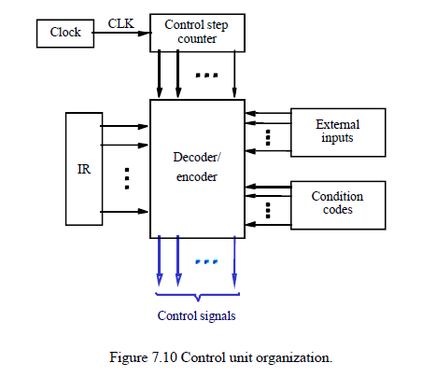
Hardwired Control Unit

Slide 5
Hardwired Control Unit
The decoder/encoder is a combinational circuit that generates a set of required control signals.
A control step counter is used to keep track of the control steps.
Each count of this counter corresponds to one control step.
The required control signals are determined by the following information:
1. contents of the control step counter
2. contents of IR register
3. contents of the condition code flags
4. External input signals, like MFC and interrupt request.

Slide 6
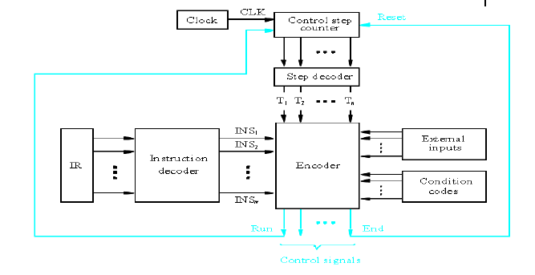
Detailed Block Description

Slide 7
Detailed Block Description
The step decoder generate a separate clock signal for each step, or time slot, in the control sequence.
The instruction decoder decodes the instruction loaded in IR.
The output of the instruction decoder consists of a separate line for each of the ‘m’ machine instruction.
According to the code in the IR, only one line amongst all output lines of decoder is set to 1 and all other lines are set to 0.
The input signals to encoder are combined to generate the individual control signals like add, read, etc.
The End signal starts the a new instruction fetch cycle by resetting the control step counter to its starting value.
When run=1, the counter to be incremented by one at the end of every clock cycle.
When run=0, the counter stops counting and this is needed whenever the WMFC signal is activated.

Slide 8
Hardwired Control Unit
Advantages of Hardwired Control Unit:
1. Fast because control signals are generated by combinational circuits.
2. The delay in generation of control signals depends upon the number of gates.
Disadvantages of Hardwired Control Unit:
1. More the control signals required by CPU, more complex will be the design of control unit.
2. No Flexibility. Modification in control signal is very difficult i.e. it requires rearranging of wires in the hardware circuit.
3. Difficult to add new feature in existing design of control unit.

Slide 9
Hardwired Control Unit Design Methods
State-table Method
Delay-element Method: Uses clocked delay element (D-Flip Flop)
Sequence-counter Method: Uses counter for timing purposes
PLA Method: Uses programmable logic array

Slide 10
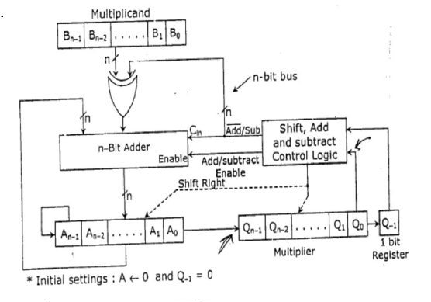
Hardwired Control Unit Design Methods (cont.)
Let us consider 2’s complement multiplier control circuit for illustration.

Slide 11
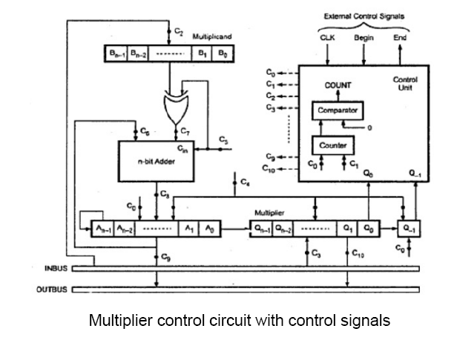
Hardwired Control Unit Design Methods (cont.)

Slide 12
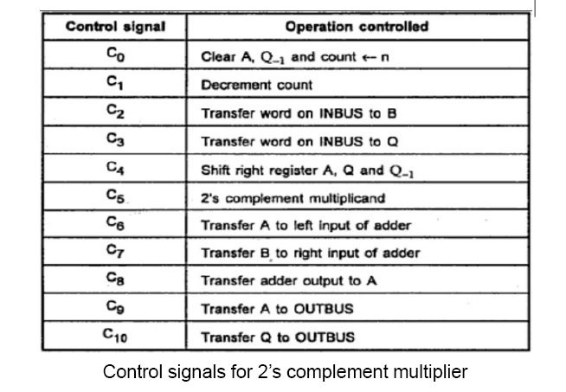
Hardwired Control Unit Design Methods (cont.)

Slide 13
State-table Method
Classical method of sequential circuit design.
Attempts to minimize the amount of hardware.
It starts with the construction of state transition table. In every state the control unit generates a set of control signals.
Control unit transmits from one state to another state depending on its:
Current state
Input to the controller

Slide 14
State Assignment: States are assigned as S1,S2,S3…;each such assignment specifies a particular state of the controller at the specific time step. State table derived from state assignment

Slide 15
2’s complement multiplier
State table construction is necessary.
Associate a state with every micro-operation block giving nine states from S0 through S8.
There are four primary input signals BEGIN, COUNT, Q0 and Q-1, so sixteen possible input combinations.
Each entry in the table indicates next state followed by list of control signals that are activated.

Slide 16
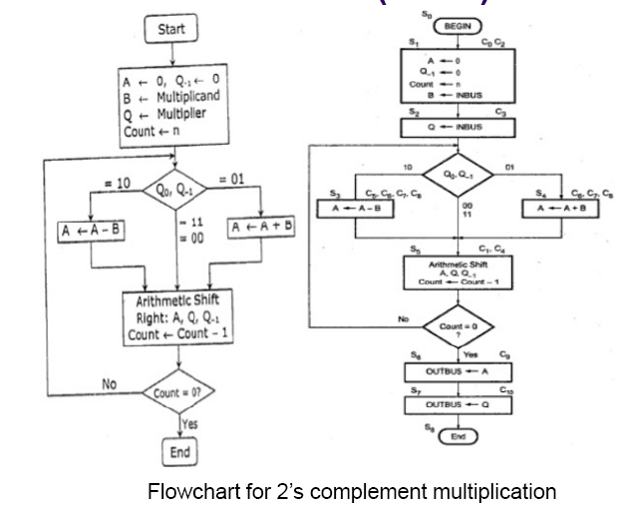

Slide 17
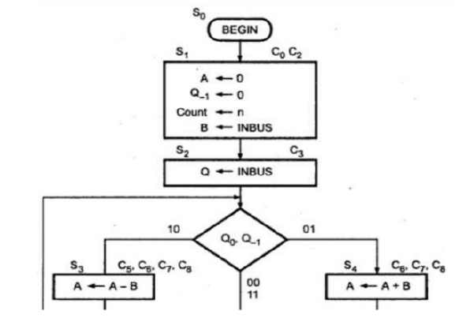

Slide 18
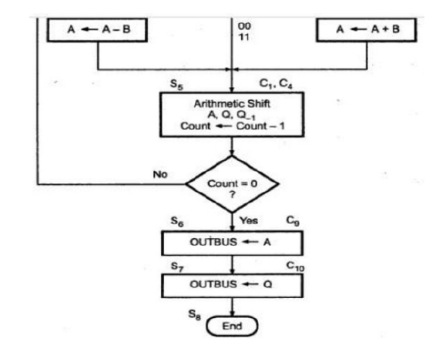

Slide 19
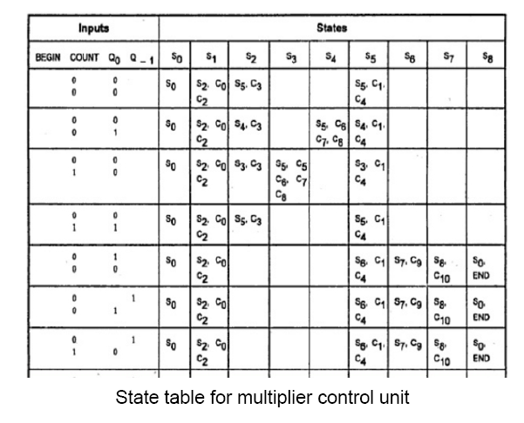

Slide 20
